Slide 1
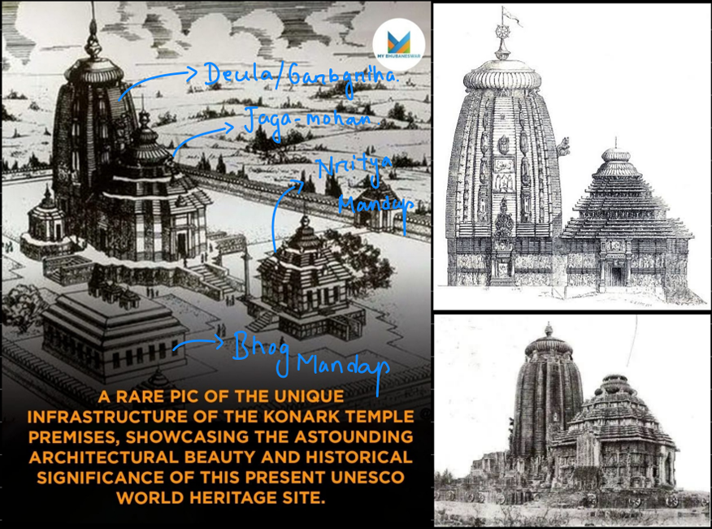
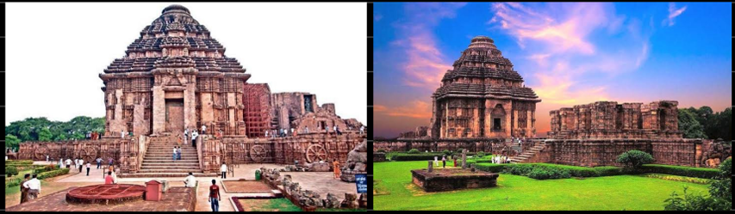
Shreenandan Sahu | CL24M013
K S Suraksha Jain | CL24M015

Slide 2
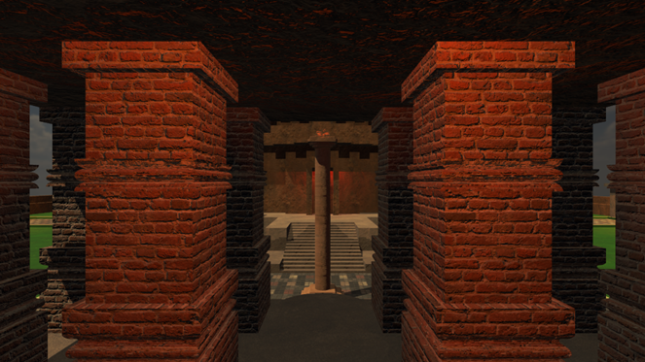
Virtually reconstruct the lost parts of the Konark Sun Temple using VR.
Provide an immersive, educational experience for cultural preservation and tourism.
Development of Hand Hold Controller for Around the Model View.

Slide 3
Things Done
3D Modeling
Textures
Sky maps
Lightings
XR Rig
Cardboard SDK
Bluetooth Plugin
Unity and Hardware Integration
3D Audio
Obstacles
Rendering Glitches
Headset and Hardware Integration

Slide 4
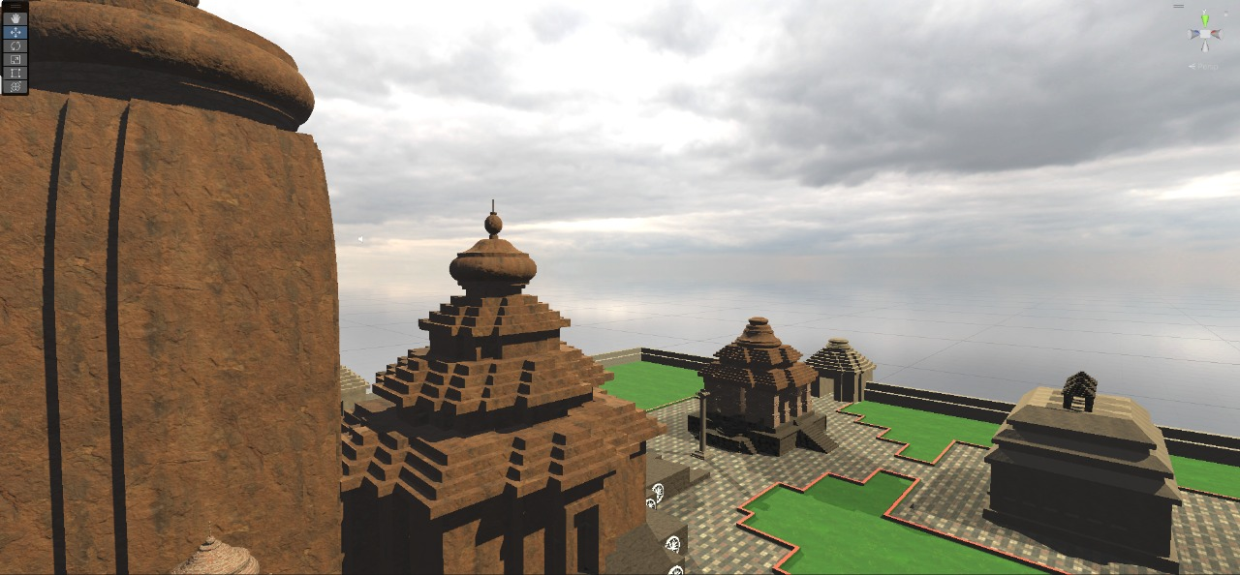
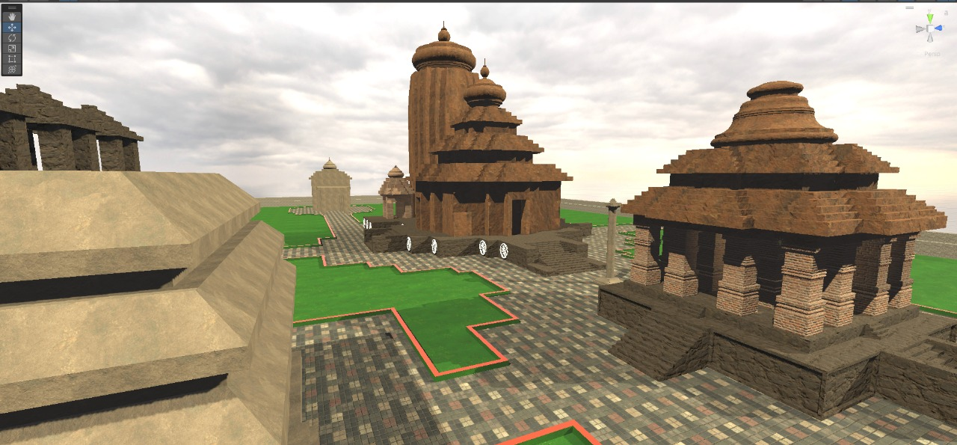
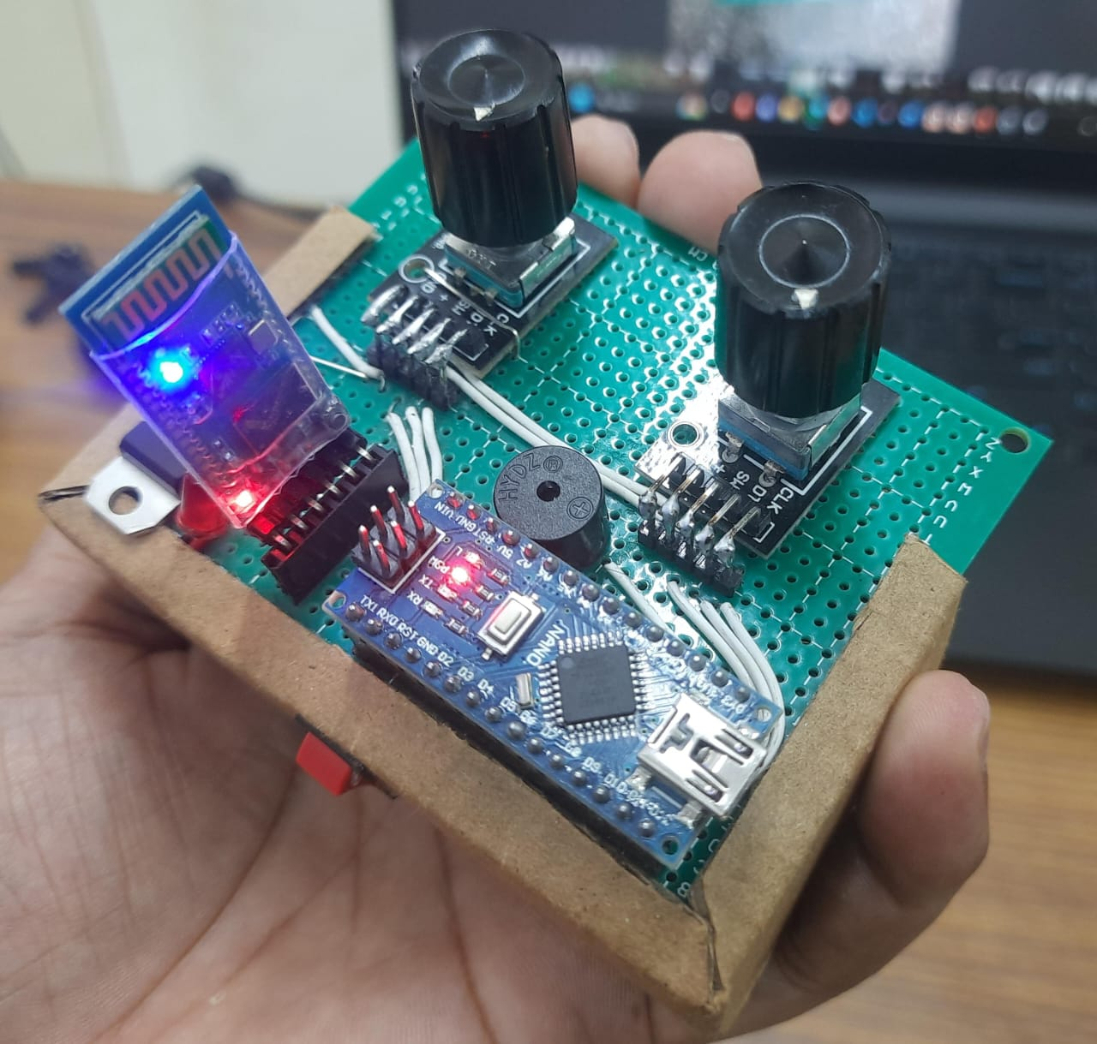
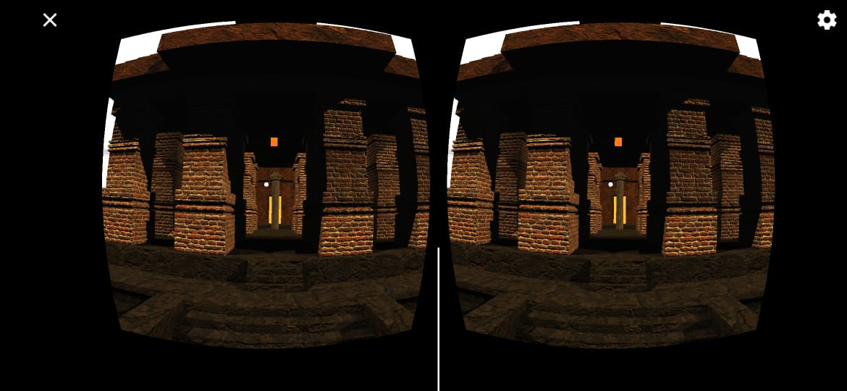
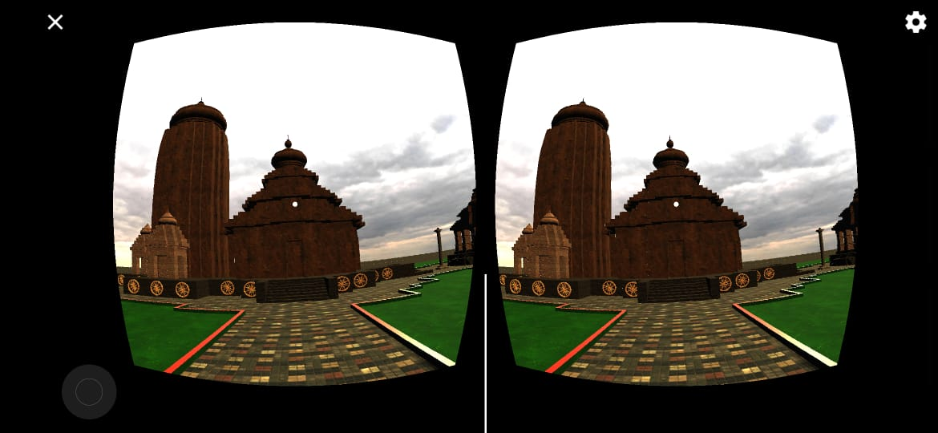
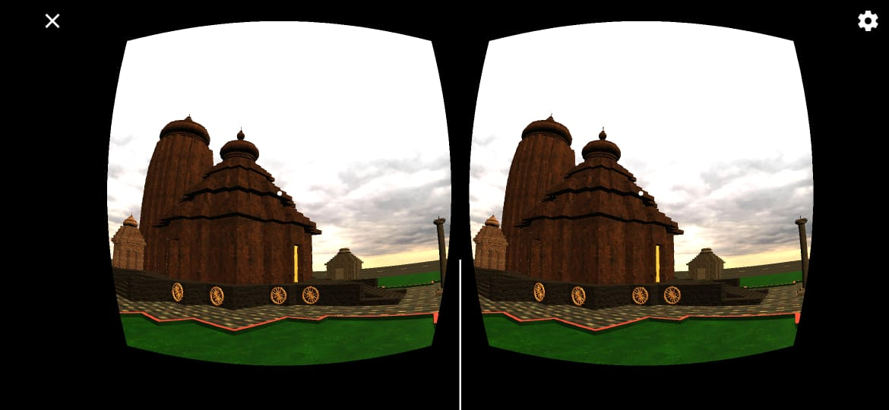
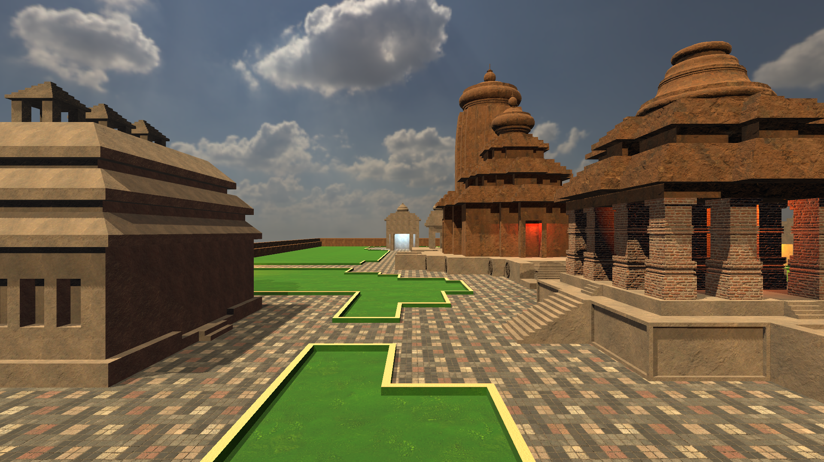
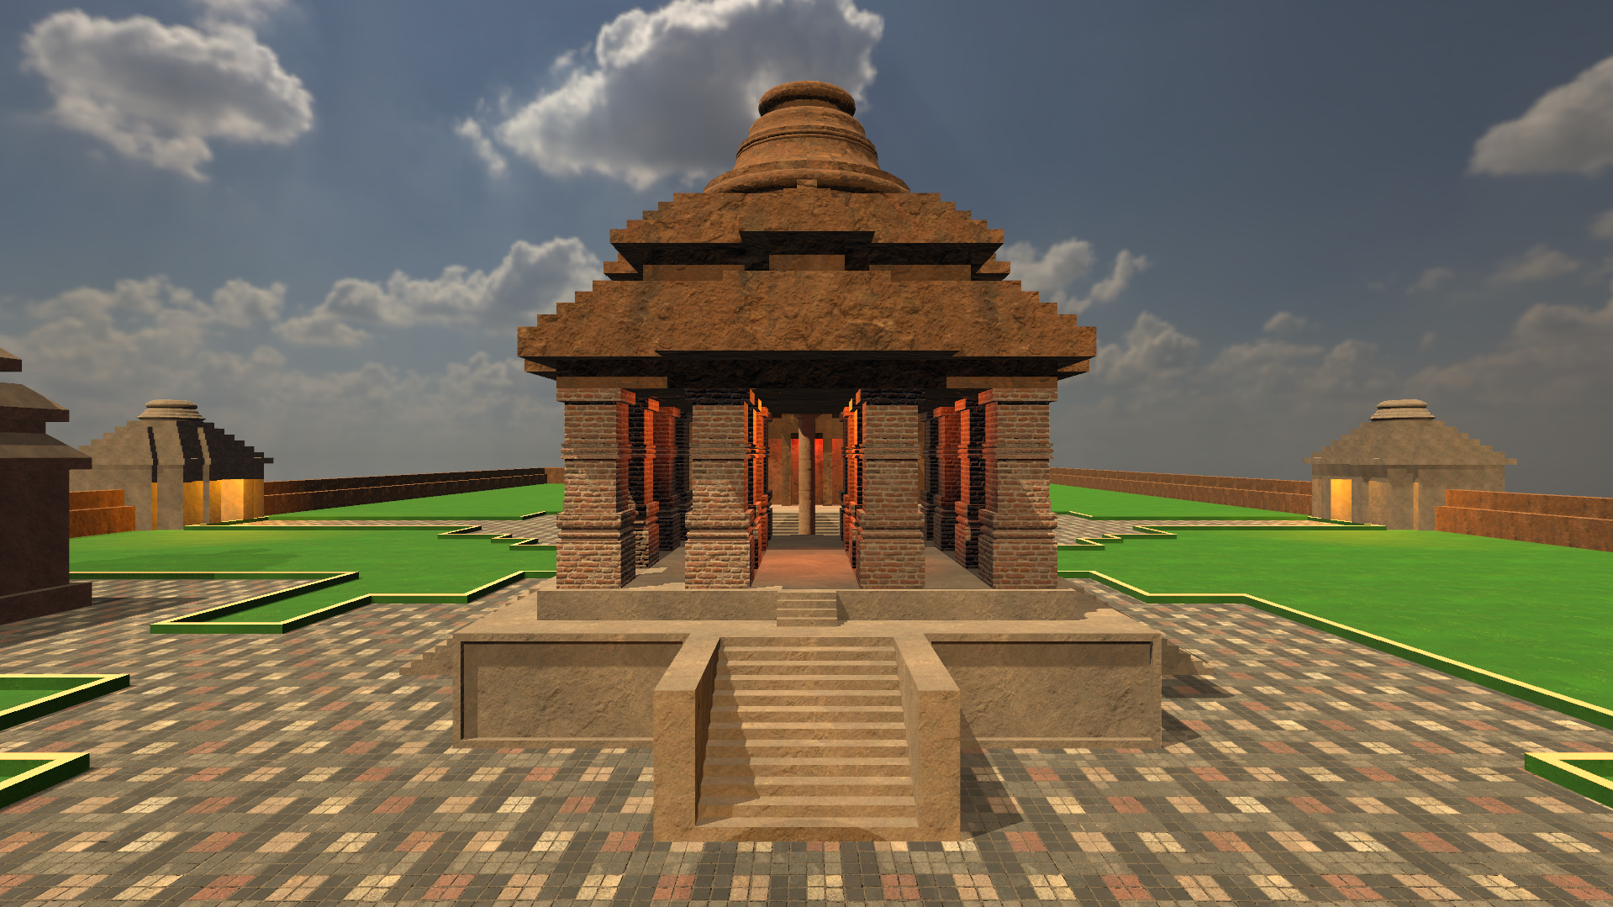
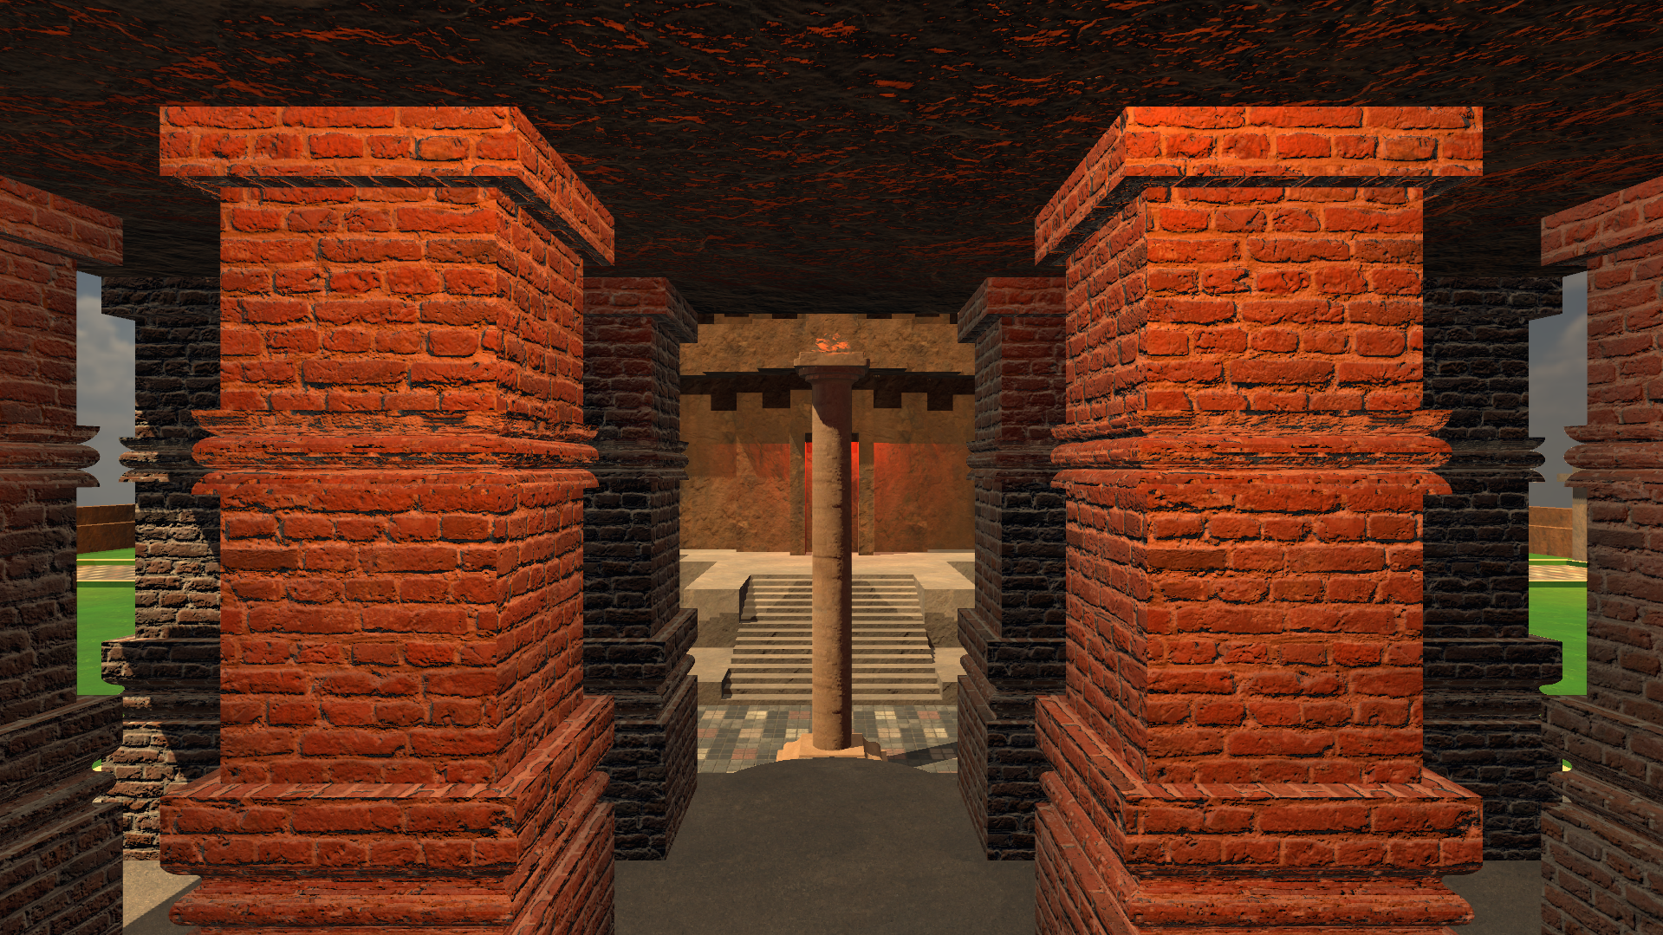
Unity Development Environment
Motion Controller
Progress Till Now
VR view
Mobile
Rendered View controlled by Hardware

Slide 5
Timeline
Phase 1: Research and data collection (1 Week)
Phase 2: 3D modelling and prototype development (2 Weeks)
Phase 3: Hardware, textures, and lighting (3 Weeks)
Phase 4: Refinements and final deployment (1 Weeks)
UI for text
Voice
Hardware Integration for mobile Device
Handling Rendering Glitches
Final Integrated APP.

